Slide 1

XIX
INTRODUCING TO YOU
MONOGRAPH
FOLIO 2019 COLLECTION
LUKE BONNER

Slide 2
opener
It’s National
RELAXATION DAY
Maybe it was back to school, maybe it was the prep for review week or something else that was stressing you out. If so, you’re not alone.

Slide 3
agenda
Virtual
Transition
Simulation
Audible
Discussion
And, you’re also in luck, since we are together. By joining our time together I will keep you engaged, inspired and diving deeper into the overall impact we deliver everyday at McKinsey.

Slide 4
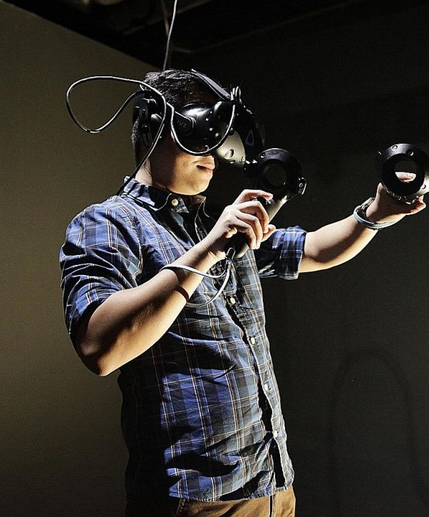
agenda
Virtual
Transition
Simulation
Audible
We Are Introducing
01
A brand new way of directly interaction with the clients and other talented colleagues. Experience studios and deep immersion technologies help clients envision what they never could before.

Slide 5

agenda
Virtual
Transition
Simulation
Audible
About Our Transition
02
That fresh and new feeling, re-born, present. Our new visual identity is brought to life by design across everything we do, how we communicate, what we say, and what these things look like. Getting us there isn’t always easy.

Slide 6




agenda
Virtual
Transition
Simulation
Audible
Our Team Delivers
03
The scenario begins in July 2021. The client is US Government office. We bring to life a simulation using new-media and copyrighting.
Partnering
Processing
Revising
Delivering

Slide 7




agenda
Virtual
Transition
Simulation
Audible
04
Explore
Our Talent
Off-camera, off-stage commentary. Voice-over is read from a script and may be spoken by someone who appears elsewhere in the production or by a specialist voice talent. In this case we are expanding our reach and tapping into a new process.

Slide 8
Boeing
Virtual
Requested by CL Hayun Cho with a deadline of 27 days,
a multi-part project
E
b
t
O
#01
#02
#03
#04
Branded ambient design elements
Overview model infographic explainer
Motion-enhanced processes come to life
Full immersion experience for
all users

Slide 9

Ambient element #001
Client Element
The guidelines and other assets were created in the beginning of our time together. Working with multiple designers and tracking the project throughout using a project management timeline.

Slide 10

Ambient element #001
more…
The result was elements to use in the immersion walkthrough and lighting effects.

Slide 11
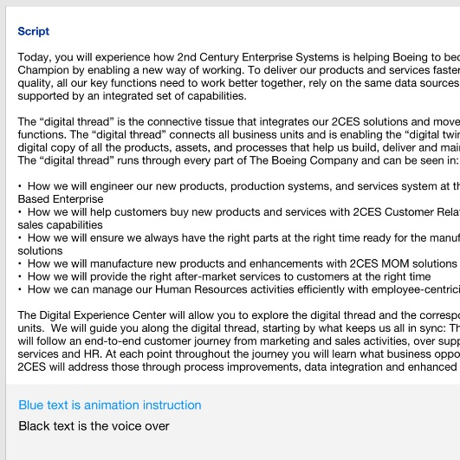
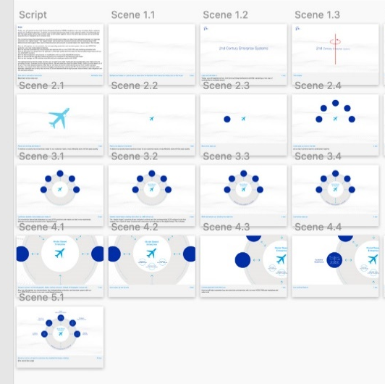
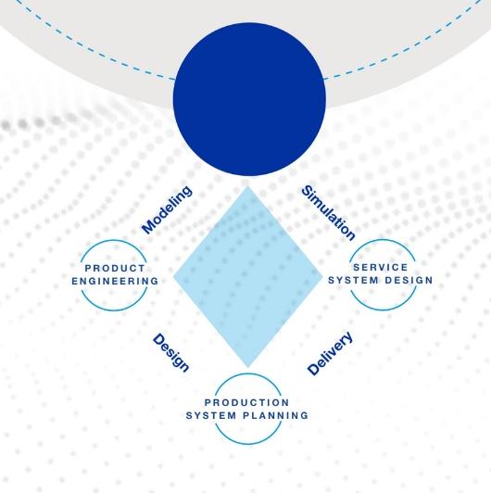
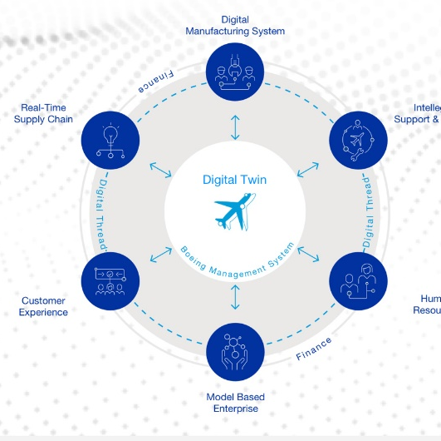
Creating inspiring animations and bringing clients visions to life. Mix media solutions.

Slide 12
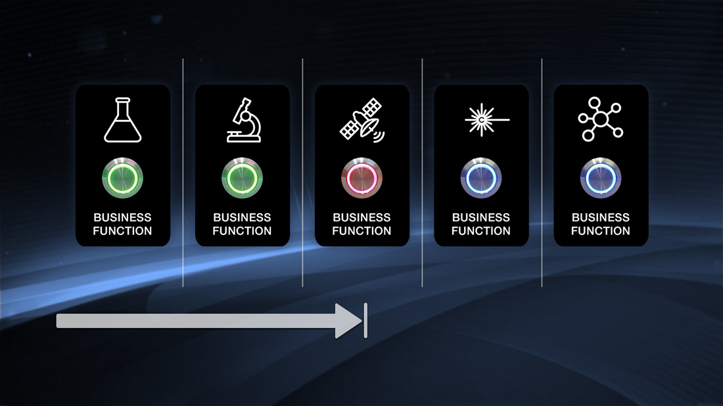
Motion #003
Before

Slide 13
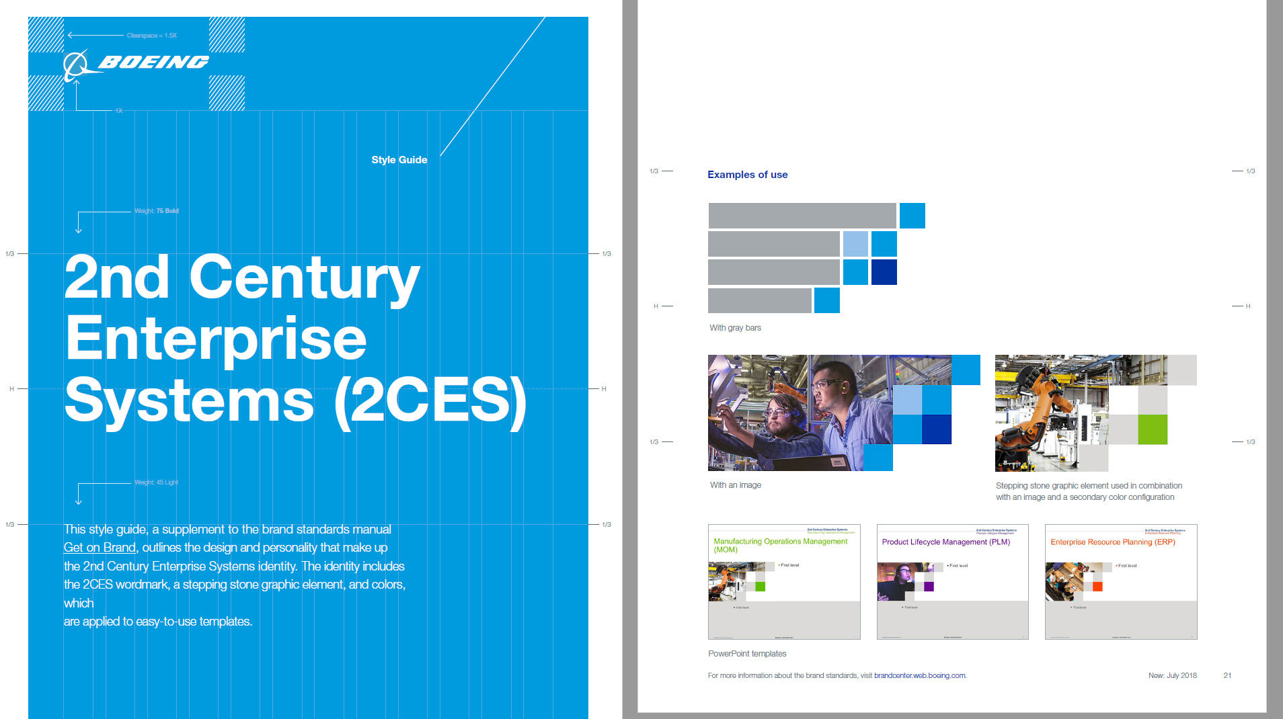
Motion #003
Client Style Guide

Slide 14


Motion #003
After

Slide 15
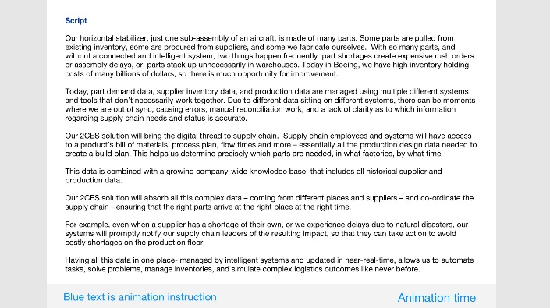
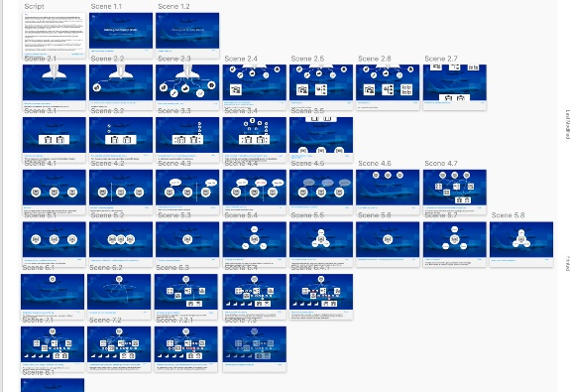
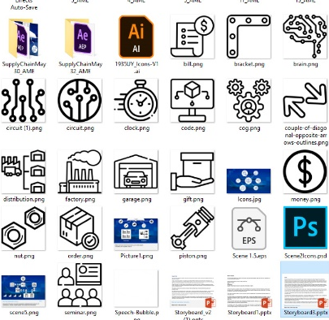


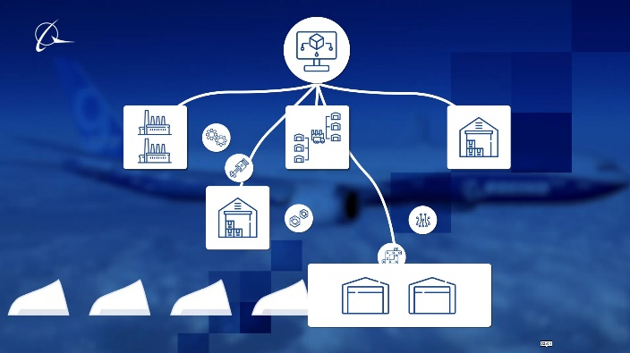
Stage #001
Editing the script and the story board anticipating all deliverables.
One stage at a time. Our construct process is tried and true.
Stage #002
Asset creation, alignment and previews. Line icon and style.
Stage #003
Editing and final production. Rendering and timing.

Slide 16
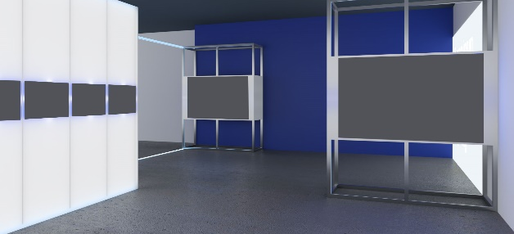
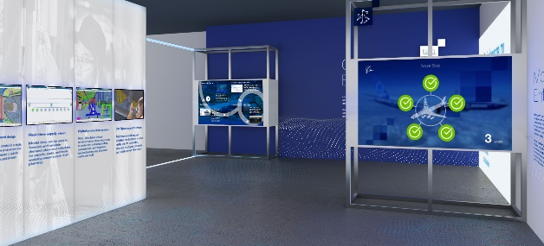
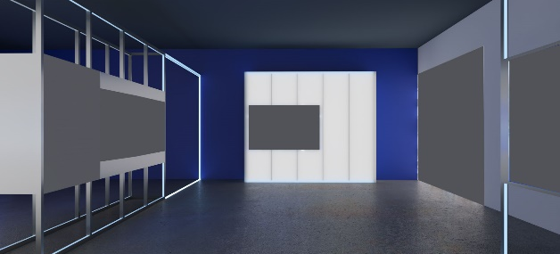
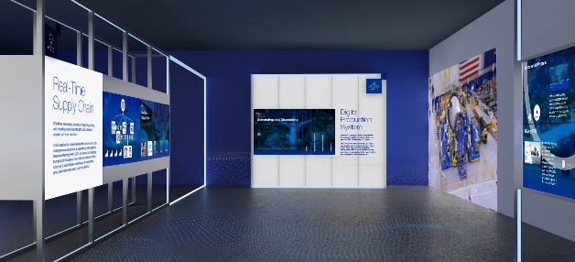
Before #001
3D walk through without post-production effects
The art of creating proposed architectural design
After #001
Lights, LCDs and digital content
Before #002
Photo realistic exports and blank panels
Architectural rendering is the art of creating two-dimensional images or animations showing the attributes of a proposed architectural design.
After #002
Virtual Tours, Floor Plans
Photo realistic 3D Rendering

Slide 17
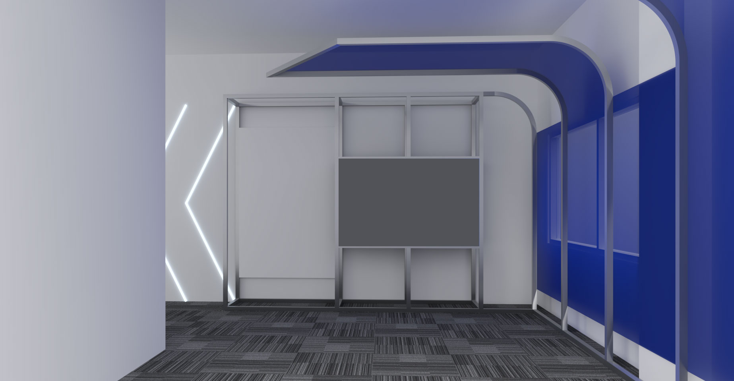

Slide 18
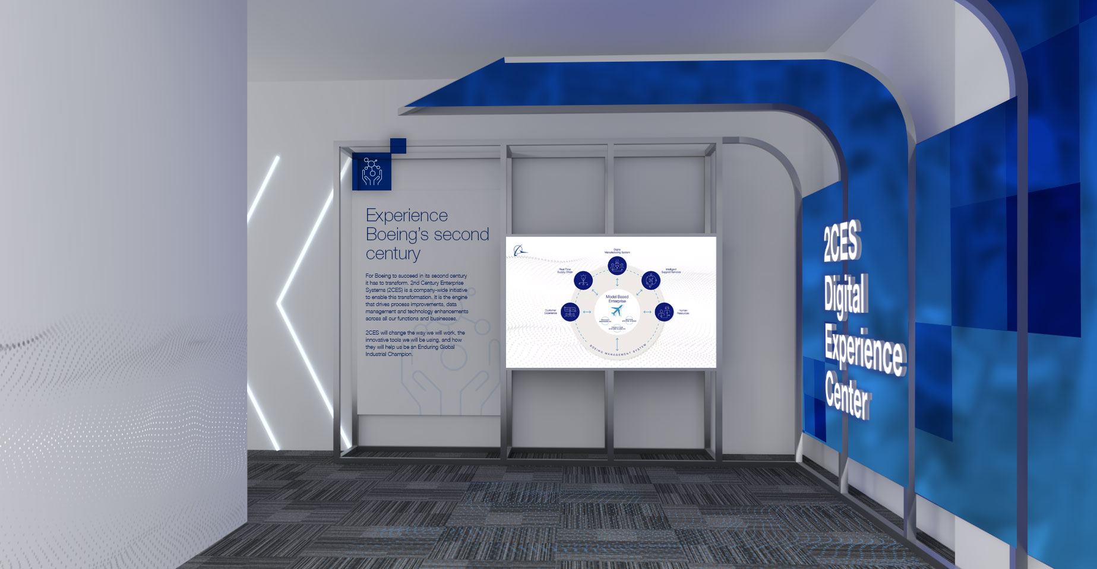

Slide 19
We want to thank you.
Your work has been truly amazing and
really helped us make so much impact.
- Hua Fan -

Slide 20
Luke,
These look awesome! Thank you!
- Hayun Cho -

Slide 21
Transition
NEW VI
Request from Solution Leader Lipi Shivaram to new visual identity over 14 days

Slide 22
Transition
Request >
I’m reaching out to you because we now need to create banners for the 6 different Ops service lines .
Lipi Chapagain Shivaram, CFA

Slide 23


< before
after >

Slide 24
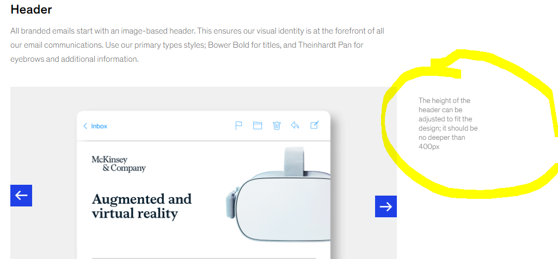
I think it’s ok, but it’s very tall, so people have to scroll down before they can see any/many words. Possible to shorten?
This is what I found on the our brand site:
Shannon Jones

Slide 25







Slide 26
Thank you for putting these together – we love the images for all of them!
Lipi Chapagain Shivaram, CFA
Solution Leader, MCK Academy

Slide 27
Simulation
We can do that
Our team delivers

Slide 28
SIMULATE
DCGOV:
Can your team bring our
War simulation to life?

Slide 29

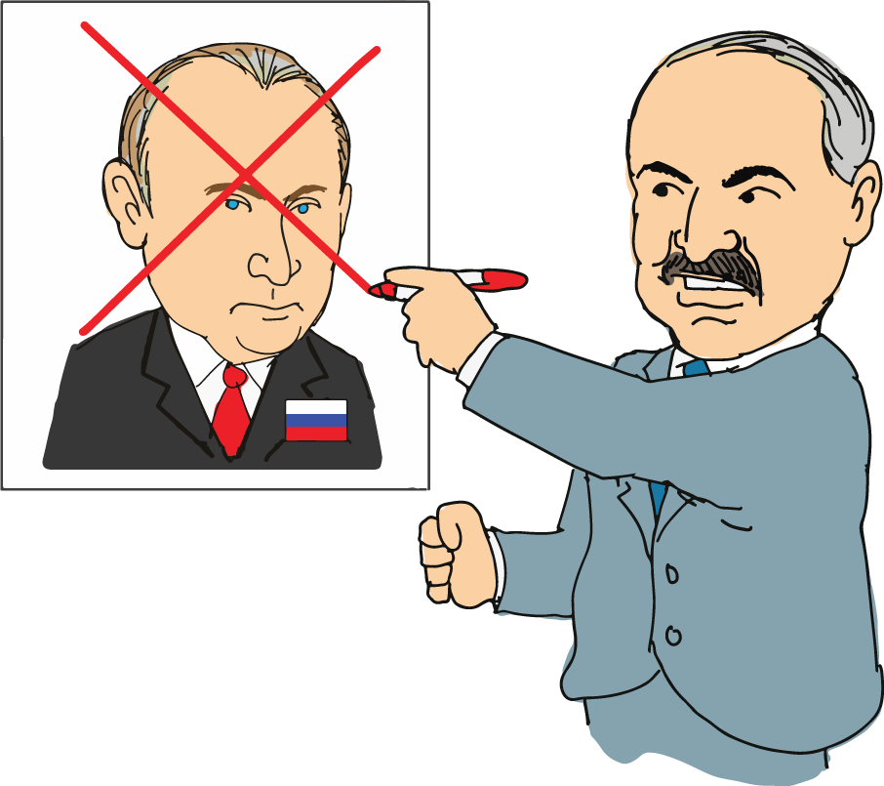
The scenario begins in July 2021. Alexander Lukashenko, who has taken a stance against Russian president Vladimir Putin, has won the 2020 Belarussian election.

Slide 30

We love the way looks! Simple illustrations, the new script with the voiceover & music gives a much more dramatic effect! 😃 great job!!
Thanks again for all your efforts! It is so appreciated.
Paulina Maleszewski
Digital Analyst

Slide 31
Our future and our team
What this means for voice over
Audible
The new class, the new service line brought to the TSC

Slide 32
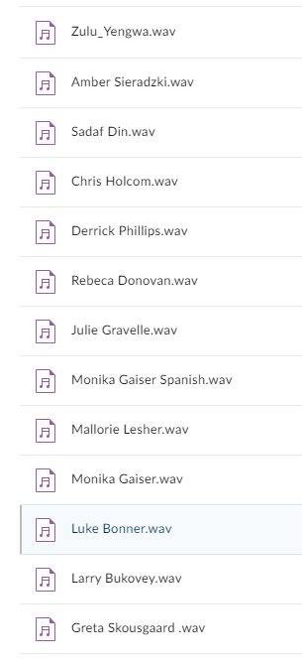
TSC Voice Bank

Slide 33
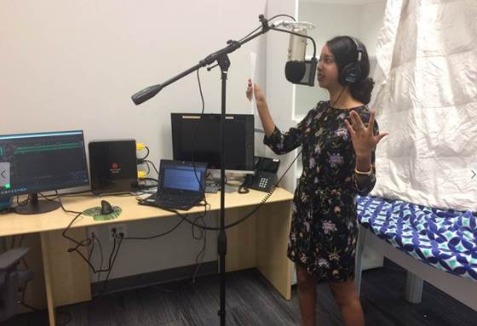

Slide 34
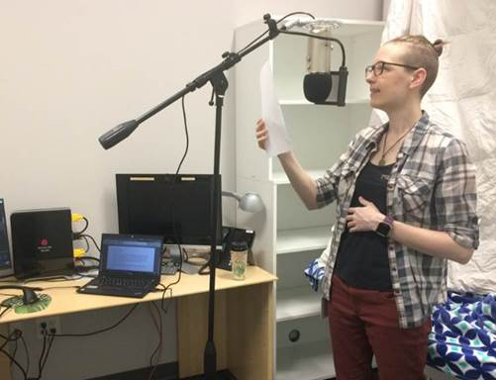

Slide 35
Feedback
I just finished listening to all the recordings. AWESOME work, I love it . - Greta S.
This looks great! Thanks a lot for the effort everyone! - Warren R.
Thanks very much for pushing forward with this and for so much dedication!! - Patrick H.

Slide 36
close
I am very
THANKFUL
Thank you for joining and I welcome any questions you may have:
luke_bonner@mckinsey.com

